Slide 1
What is the Control Logic ?
Part of the computer that is outputting the Control Signals based on each specific instruction.
So far we have been using our Arduino Mega Shield to set the control signals to High/Low
We are building the control logic to output the required Control signals for each specific instruction.

Slide 2
How a computer execute programs ?
Program Counter
When the computer starts, Program counter starts counting from 0
With each step, the value is put on the BUS
Signal : CO
Memory Address Register
MAR reads the value from the BUS and set the Address to the value
Signal : MI
Next Step
Signal : CE
Memory (FLASH/RAM)
Outputs the content of memory address on the BUS
Signal : RO
Control Logic
Flag Register
The Status of Flags saved into this register
Signal : FI
Instruction register
BUS content is the next instruction to be executed
Signal : II
Micro Step Counter
A counter that counts micro steps
Output is Addressing a ROM
Control ROM
CE ME CI CO AI AO BI BO MI RO FI EO .…..

Slide 3
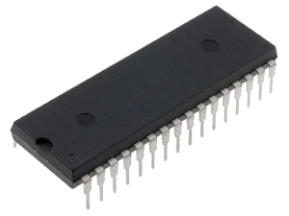
Control Logic in Bravo
Control Logic
Flag Register
The Status of Flags saved into this register (3 Bits)
Signal : EOFI
Instruction register
BUS content is the next instruction to be executed (6 Bits)
Signal : HI + CEME = II
Micro Step Counter
A counter that counts micro steps (4 Bits)
Control ROMs
MSB
LSB
2 x SST39SF010
Each 128 KB
8 Signals
8 Signals
CE ME CI CO AI AO BI BO MI RO FI EO .…..

Slide 4
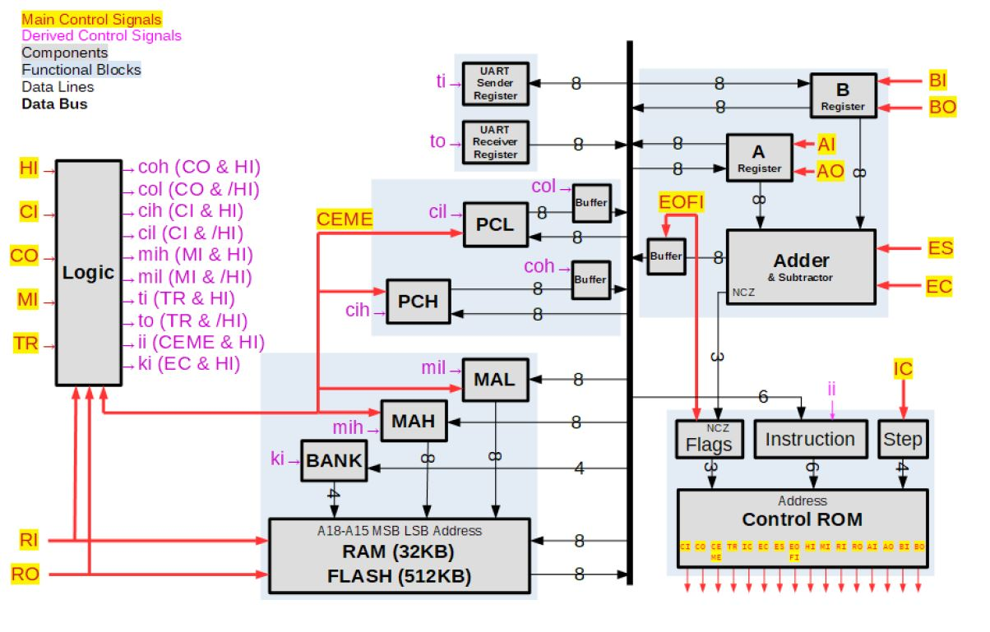
How Bravo execute programs ?
Fetch Instruction
CO , MI
CO, MI, HI
RO, HI, CEME
CO , MI
CO, MI, HI
RO, HI, CEME
RO, AI, CEME,IC
Example: LDI

Slide 5
What is a program ?
Program
to add
X & Y
Load X value directly into A register
Load Y value from memory and ADD it
Output the result
Instructions
1
2
3
LDI 10
ADD 01 80
OUT
Instruction
(Mnemonics used in programming)
Operand
(Memory Location, Contains Y)
Instruction
Operand
(Value of X)
LDI 10
Signals
Micro steps
Load value of 10 directly to A register
Load the Value of memory Address 8001(HEX) into B register
Output the content of the BUS
CO , MI
CO, MI, HI
RO, HI, CEME
RO, AI, CEME,IC

Slide 6
Microcode in Bravo
+
+
0000 (4 bits)
Flags (3 bits)
8 possible combinations
Instruction(6 bits)
64 different instructions
Micro Steps(4 bits)
16 Micro steps
4 + 13 bits
Total of 17 bits , addressing ROMs using 17 address lines
Each Instruction is assigned a binary value, For Example
LDI is assigned value of 14
STA is assigned value 21
Etc..
Mnemonic | Filler Bits (4 Bits) | Flags (3 Bits) | Instruction (6 Bits) | Steps (4Bits) |  | Control Signal
LDI | 0000 | 000 | 001110 | 0000 | Step0 | CO, MI
LDI | 0000 | 000 | 001110 | 0001 | Step1 | CO,MI,HI
LDI | 0000 | 000 | 001110 | 0010 | Step2 | RO,HI,CEME
LDI | 0000 | 000 | 001110 | 0011 | Step3 | RO,AI,CEME,IC
LDI | 0000 | 000 | 001110 | 0100 | Step4 | -
LDI | 0000 | 000 | 001110 | 0101 | …. | -

Slide 7
Microcode in Bravo
3 Flags
(8 combinations)
LDA 101001 Step0 0000 CO|MI
LDA 101001 Step1 0001 CO|MI|HI
LDA 101001 Step2 0010 RO|HI|CEME
LDA 101001 Step3 0011 RO|BI|CEME
. . . .
. . . .
LDA 101001 Step15 1111 .
000
001
010
.
LDA 101001 Step0 0000 CO|MI
LDA 101001 Step1 0001 CO|MI|HI
LDA 101001 Step2 0010 RO|HI|CEME
LDA 101001 Step3 0011 RO|BI|CEME
. . . .
. . . .
LDA 101001 Step15 1111 .
LDA 101001 Step0 0000 CO|MI
LDA 101001 Step1 0001 CO|MI|HI
LDA 101001 Step2 0010 RO|HI|CEME
LDA 101001 Step3 0011 RO|BI|CEME
. . . .
. . . .
LDA 101001 Step15 1111 .
x
x
Flags (3 bits)
8 possible combinations
Instruction(6 bits)
64 different instructions
Micro Steps(4 bits)
16 Micro steps
8192 Total Micro Instructions , 8K

